Slide 1
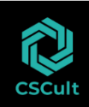
Cloud Delivery Models
Module Number: 02
Module Name: Cloud Delivery Models
Deepak Solanki
Div Head Cloud Team
CSCult

Slide 2
Cloud Delivery Models
AIM:
To provide students with a good understanding of the benefits and risks of different cloud delivery
models.
2

Slide 3
Cloud Delivery Models
Objectives:
The Objectives of this module are:
Describe the various cloud delivery models
Explain IaaS and its components
Discuss the impact of cloud services using examples
3

Slide 4
Cloud Delivery Models
Outcome:
At the end of this module, you are expected to:
Outline the various cloud delivery models
Discuss IaaS and its components
Determine the impact of cloud services
4

Slide 5
Cloud Delivery Models
Contents
Cloud Delivery Models
Infrastructure as a Service
Platform as a Service
Software as a Service
Other types of Cloud Services
5

Slide 6
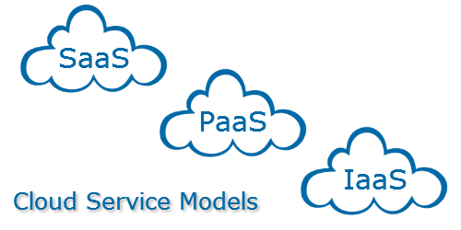
Cloud Delivery Models
We have learnt the basics of cloud computing in chapter 1.
We also learnt various deployment models that are used.
Now, let us understand the services provided by cloud along with the service/delivery models that are used to deliver these services.
6

Slide 7



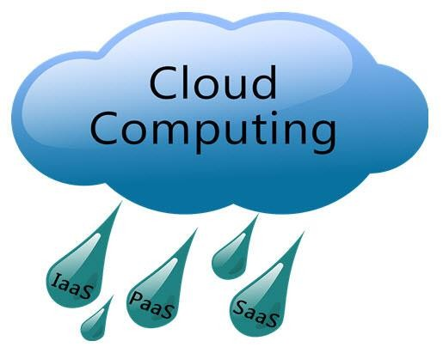
Cloud Delivery Models
I have a lot of files to store which I work on but there is not enough space on my laptop.
Hey! Why don’t you use Dropbox to store your files?

Slide 8
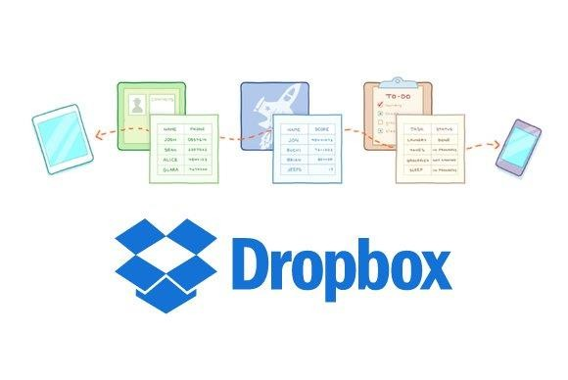

Cloud Delivery Models
Dropbox is an example of a cloud storage service. We can store our files and then access them
from any location and device when required.
Similarly, when we access our e-mail that is stored on an e-mail server elsewhere in the world, we are actually accessing an application as a service – a form of cloud service.

Slide 9
Cloud Delivery Models
Cloud Services – Pyramid Model:
NIST defines three service models: SaaS, Paas and IaaS.
The figure depicts their relationship as a hierarchical model with each layer consuming elements of the layers below it.
Saas
SaaS – Software as a Service
PaaS
PaaS – Platform as a Service
IaaS
IaaS – Infrastructure as a Service

Slide 10
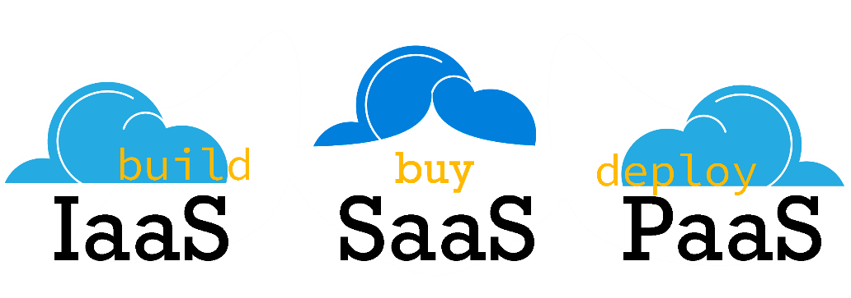
Cloud Delivery Models
Cloud Service Models
Cloud resources can be consumed by:
Other cloud services
Traditional electronic devices
Users using web browsers
IaaS is at the fundamental level which includes services such a networking, storage and other architectural elements for system administrator and enterprise planners.
Application developers consume services at PaaS level.
The applications developed are consumed by the users at the SaaS level.

Slide 11
Cloud Delivery Models
Users
Application
Developers
System Admin
Apps
Platform
Infrastructure
What is found at each level?
Who consumes each level?

Slide 12
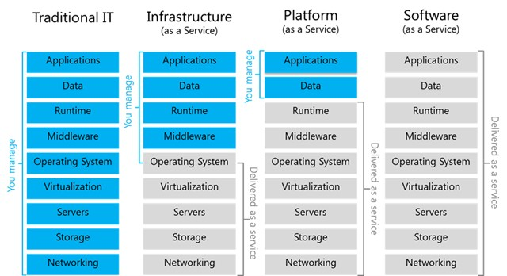
Cloud Delivery Models
Traditional IT vs. Cloud Services Models

Slide 13
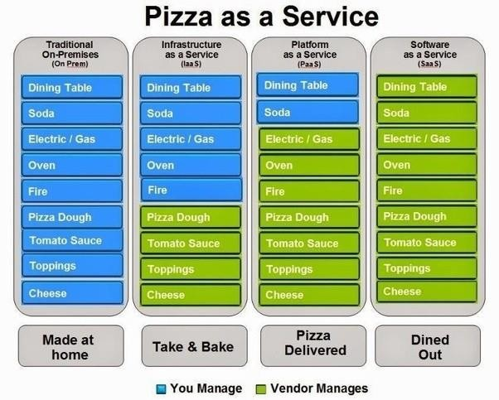
Cloud Delivery Models
Traditional IT vs. Cloud Services Model – Pizza Analogy

Slide 14
Cloud Delivery Models
Self-Assessment Question
The three service models defined by NIST does not include:
Infrastructure as a service
Information as a service
Software as a service
Platform as a service
Answer: Information as a service

Slide 15
Cloud Delivery Models
Self-Assessment Question
The service used by developers to develop applications is:
SaaS
IaaS
PaaS
Daas
Answer: PaaS

Slide 16
Cloud Delivery Models
Self-Assessment Question
HaaS stands for:
Hardware as a service
Home network as a service
Answer: Hardware as a service

Slide 17
Cloud Delivery Models
Self-Assessment Question
model delivers all IT components as a service.
PaaS
SaaS
Answer: SaaS

Slide 18
Cloud Delivery Models
Infrastructure as a Service

Slide 19
Cloud Delivery Models
IaaS
Platform Virtualization
Service Level Agreement (SLA)
IaaS Networking
Virtual Private Cloud
IaaS Storage
IaaS Security
Cloud Data Protection
Cloud Pricing
Cloud Migration
IaaS Benefits and Risks
IaaS Examples

Slide 20
Cloud Delivery Models
Why do companies rent external infrastructure?
There are four reasons:
Price – renting is cheaper.
Aggregation of Resources – helps in scaling the resources up or down.
Speed of Deployment – no overhead of maintenance means faster deployment of products.
Security – service providers take care of security issues such as Denial of
service attacks.

Slide 21
Cloud Delivery Models
Overview of Infrastructure as a Service:
Infrastructure as a Service is also called as Hardware as a Service (HaaS).
Virtualized resources (CPU, memory, storage and eventually service substrates) are used (on a pay per use basis) by applications.
IaaS helps you avoid the expense and complexity of buying and managing your own physical servers and other data center infrastructure. Each resource is offered as a separate service component and you only need to rent a particular one for as long as you need it.
Currently, the most high-profile IaaS operation is Amazon’s Elastic Compute Cloud (Amazon EC2). It provides a Web interface that allows customers to access virtual machines. EC2 offers scalability under the user’s control with the user paying for resources by the hour.

Slide 22
Cloud Delivery Models
Common IaaS Business Scenarios
Businesses use IaaS for:
Test and Development: test environments can be quickly setup and dismantled as a result of which new applications can be brought to the market faster.
Web Hosting: using IaaS for web hosting is less expensive.
Storage, Backup and Recovery: the need for physical storage can effectively be eliminated, as IaaS is useful in handling unpredictable demand in storage requirements.
High-Performance Computing: using super computers for highly complex computing such as
earthquake simulations.
Big Data Analysis: mining large amounts of data sets to analyse and find useful patterns within requires huge processing, which IaaS can provide economically.

Slide 23
Cloud Delivery Models
Virtualization:
Virtualization is a fundamental mechanism for delivering cloud services.
Virtualization refers to the creation of a virtual resource such as a server, desktop, operating system, file, storage or network.
The main goal of virtualization is to manage workloads by radically transforming traditional computing
to make it more scalable.
The most common form of virtualization is the operating system-level virtualization. In operating system-level virtualization, it is possible to run multiple operating systems on a single piece of hardware.
Virtualization technology involves separating the physical hardware and software by emulating hardware using software. When a different OS is operating on top of the primary OS by means of virtualization, it is referred to as a virtual machine.
A virtual machine is nothing but a data file on a physical computer that can be moved and copied to another computer, just like a normal data file.

Slide 24
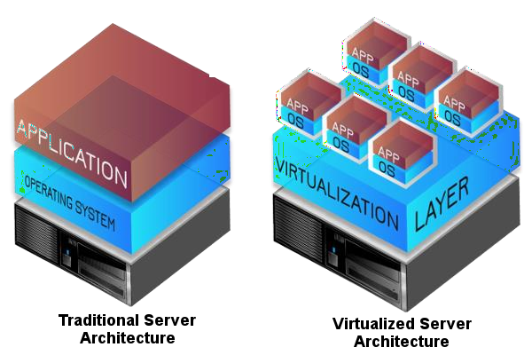
Cloud Delivery Models
Virtualization:
Virtualization provides a platform for optimizing complex IT resources in a scalable manner
(efficiently growing), which is ideal for delivering services.

Slide 25

Cloud Delivery Models
Characteristics of Virtual Machines:
Virtualization has three characteristics that make it ideal for cloud computing:
Partitioning: In virtualization, many applications and operating systems (OS) are supported in a single physical system by partitioning (separating) the available resources.
Isolation: Each virtual machine is isolated from its host physical system and other virtualized machines. Because of this isolation, if one virtual instance crashes, it does not affect the other virtual machines. In addition, data are not shared between one virtual container and another.
Encapsulation: A virtual machine can be represented (and even stored) as a single file, so that you can easily identify it based on the service it provides. In essence, the encapsulated process could be a business service. This encapsulated virtual machine can be presented to an application as a complete entity. Therefore, encapsulation can protect each application so that it does not interfere with another application.

Slide 26

Cloud Delivery Models
Using a Hypervisor in Virtualization:
A hypervisor is an operating system, which makes things happen in an orderly manner.
The hypervisor sits at the lowest levels of the hardware environment.
Because in cloud computing you need to support many different operating environments, the hypervisor becomes an ideal delivery mechanism.
The hypervisor lets you show the same application on lots of systems without having to physically copy that application onto each system.
It is designed like a mainframe OS rather than the Windows operating system.
The hypervisor, therefore, schedules the amount of access everything that guest OSes
have to from the CPU, to memory, to disk I/O and to any other I/O mechanisms.
With virtualization technology, you can set up the hypervisor to split the physical computer’s resources.

Slide 27
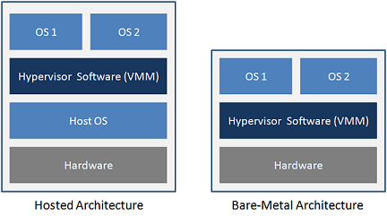
Cloud Delivery Models
Types of Hypervisor:
Different hypervisors support different aspects of the cloud.
Hypervisors come in several types:
Native hypervisors, which sit directly on the hardware platform, are most likely used to gain better performance for individual users.
Hosted hypervisors run as a distinct software layer above both the hardware and the OS. This type of hypervisor is useful both in private and in public clouds to gain performance improvements.
Embedded hypervisors are integrated into a processor on a separate chip. Using this type of hypervisor is how a service provider gains performance improvements.

Slide 28
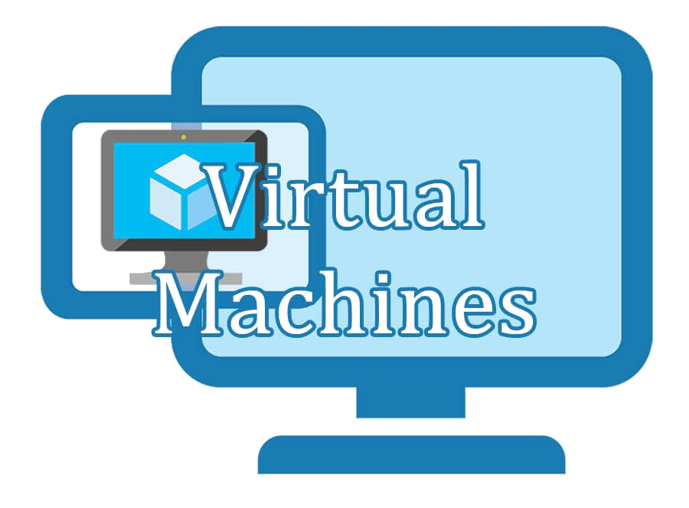
Cloud Delivery Models
Virtualization Benefits:
Virtualization offers many practical benefits including the following:
New systems can be setup easily.
No need to invest in hardware for testing and debugging setups.
The capability to recover quickly from system corruption.
Relocating and migrating systems with ease. For example, moving to a more powerful machine can simply be a matter of taking a snapshot of a virtual machine and starting up a new virtual machine based on that snapshot.
The ease of remote management. Physical access to data centers is tightly controlled these days. The use of virtual machines greatly reduces the need for physical access.
Multiple operating systems can be run simultaneously on one server.

Slide 29
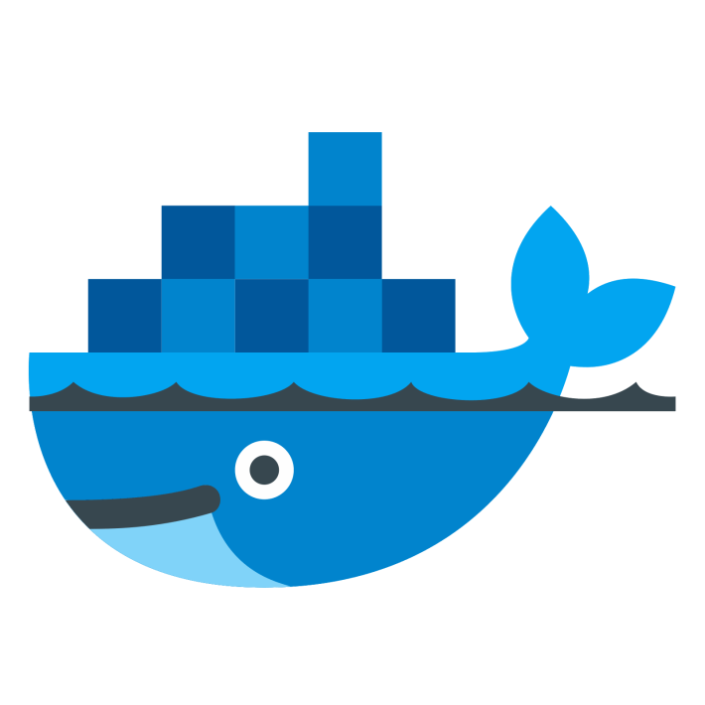
Cloud Delivery Models
Containers:
Containers are an alternative to Virtual Machines (VMs) used in
cloud computing.
A container is designed to virtualize a single application instead of the entire operating system.
For example, if you have a MySQL container, it provides a virtual instance of the application and that is all it does.
Containers create an isolation at application level rather than at server level. Therefore, any issues like over consumption of resources by a process affects only that container not the whole VM.

Slide 30
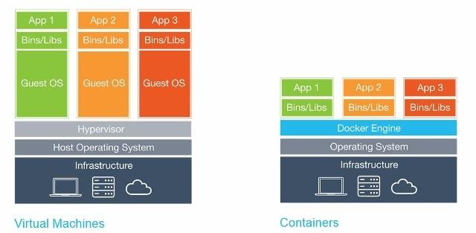
Cloud Delivery Models
Virtual Machines vs Containers:
Instead of virtualizing the BIOS and hardware, like a virtual machine, containers operate on top of a shared operating system.
However, because containers do not need to utilize the extra hardware required to run their own operating systems, you can run as many as 4× or 6 × the number of containers more than VMs.

Slide 31
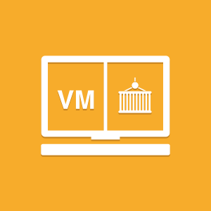
Cloud Delivery Models
Advantages of Containers over Virtual Machines:
Containers can initiate in milliseconds compared with VMs which initiate in
minutes.
Containers use less resources resulting in faster performance than VMs.
The ability to operate more containers in the same amount of space taken by
a VM.
Disadvantages of Containers:
Containers can be harder to manage than VMs, especially when there is a
large number of containers.
Containers are less secure than VMs as each container can be a potential attack surface depending on permissions given to the app.

Slide 32
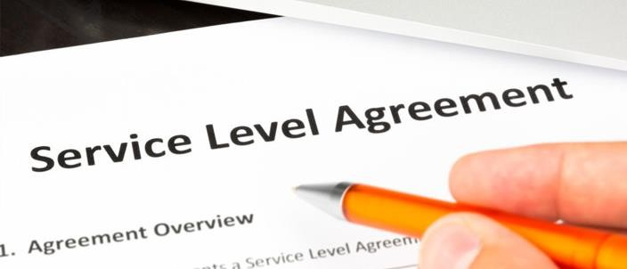
Cloud Delivery Models
Service Level Agreement (SLA)
Think of building a new home or buying a new car, we expect to have a blueprint for
the house or warranty to be given with the purchase of the new car.
A service level agreement (SLA) serves as both a blueprint and warranty for cloud computing.
An SLA is a contract between a service provider (either internal or external) and the end user that defines the level of service expected from the service provider.
SLAs define what the customer will receive, not how the service itself is provided or delivered.
A` telecom company's SLA, for example, may promise network availability of 99.999 percent (that works out to about five and a quarter minutes of downtime per year, which can still be too long for some businesses), and allow the customer to reduce their payment by a given percentage if it is not achieved usually based on the
magnitude of the breach.

Slide 33
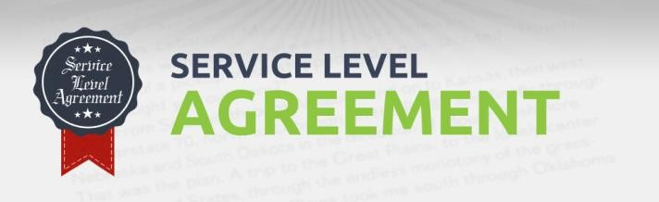
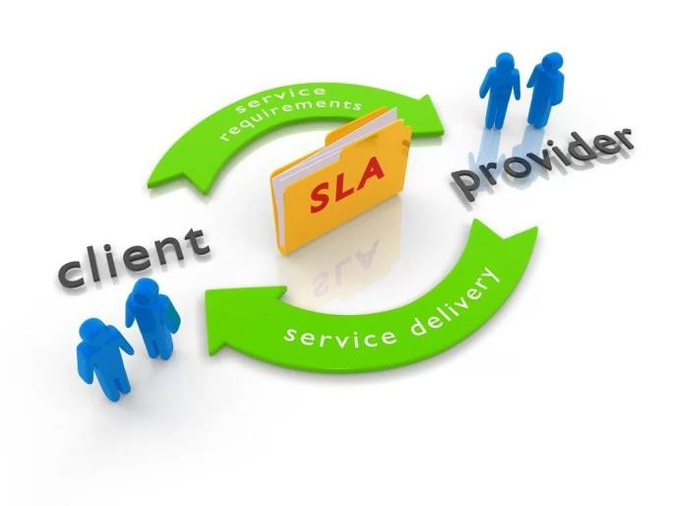
Cloud Delivery Models
Virtual Private Cloud (VPC)
A virtual private cloud (VPC) is a hybrid model of cloud computing in which a private cloud solution is provided within a public cloud provider’s infrastructure.
VPC is a cloud computing service in which a public cloud provider isolates a specific portion of their public cloud infrastructure to be provisioned for private use. The VPC infrastructure is managed by a public cloud vendor; however, the resources allocated to a VPC are not shared with any other customer.
VPC are specifically for those who want to benefit from cloud yet have some concerns about privacy, security and loss of control over proprietary data.
VPC customers are given dedicated cloud servers, virtual networks, cloud storage and private ID addresses.
Examples for VPCs include Amazon VPC and Google App Engine.
32

Slide 34
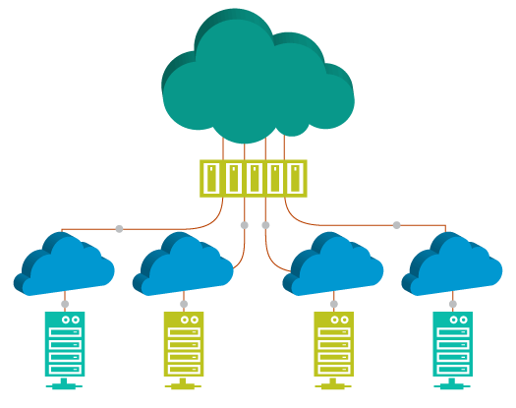
Cloud Delivery Models
Virtual Private Cloud
A virtual private cloud (VPC) is a hybrid model of cloud computing in which a private cloud solution is provided within a public cloud provider’s infrastructure.
VPC is a cloud computing service in which a public cloud provider isolates a specific portion of their public cloud infrastructure to be provisioned for private use. The VPC infrastructure is managed by a public cloud vendor; however, the resources allocated to a VPC are not shared with any other customer.
VPC are specifically for those who want to benefit from cloud yet have some
concerns about privacy, security and loss of control over proprietary data.
VPC customers are given dedicated cloud servers, virtual networks, cloud storage and private ID addresses.
Examples for VPCs include Amazon VPC and Google App Engine.

Slide 35
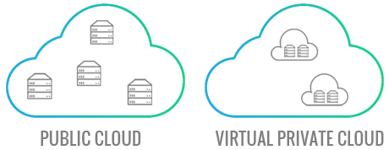
Cloud Delivery Models
Benefits of Virtual Private Cloud
Bandwidth Efficiency
Application Performance
Security

Slide 36
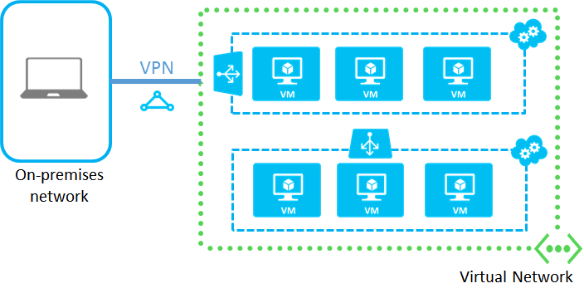
Cloud Delivery Models
IaaS Networking

Slide 37
Cloud Delivery Models
IaaS Networking
Network resources can be virtualized just like other cloud resources. To do this, a cloud uses
virtual switches to separates a physical network into logical partitions.
A virtual network is like a LAN. It is an isolated address space that can be divided into automatically routed subnets.
Virtual LANS (VLANs) can act as an extension of the enterprise’s private network. You can connect to it via an encrypted Virtual Private Network (VPN) connection.
A hypervisor can share a single physical network interface with multiple virtual machines.
Each virtual machine has one or more virtual network interfaces.

Slide 38
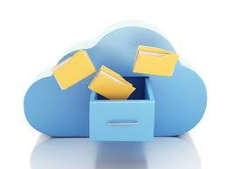
Cloud Delivery Models
IaaS Storage overview
IaaS storage can be very complex. It involves creating a resource pool which may include virtualized storage and tie it up with orchestration to support cloud requirements such as moving running VMs between servers and taking instant snapshots of multi terabyte virtual drives.
Networked storage services are generally classified in the way they are consumed and interfaced with on the client side. The thee types of storage are:
File storage
Block storage
Object Storage

Slide 39
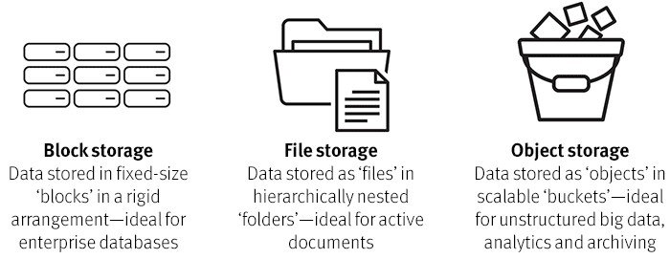
Cloud Delivery Models
File Storage:
The most traditional service type is a shared file system, or simply “file storage” which allows users to access shared folders. The two most popular shared file system protocols in use today are Network File System (NFS) and SMB/CIFS (Server Message Block/Common Internet File System).

Slide 40
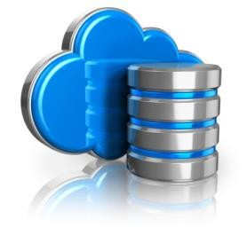
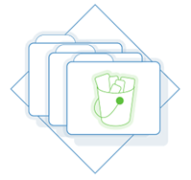
Cloud Delivery Models
Block Storage
Block storage devices provide fixed-sized raw storage capacity. Each storage volume can be treated as an independent disk drive and controlled by an external server operating system.
The most common examples of Block Storage are SAN, iSCSI, and local disks.
Block storage devices typically are formatted with a file system like FAT32, NTFS, EXT3, and EXT4.
Object Storage
Data kept on object storage devices consist of the object data and metadata. It can be any kind of data such as photos, videos, and log files
It can be accessed directly through APIs or http/https.
The object store guarantees that the data will not be lost. Object storage data can be replicated across different data centers and offer simple web services interfaces for access.
It is ideal to store unstructured data like music, image, and video files.
40

Slide 41
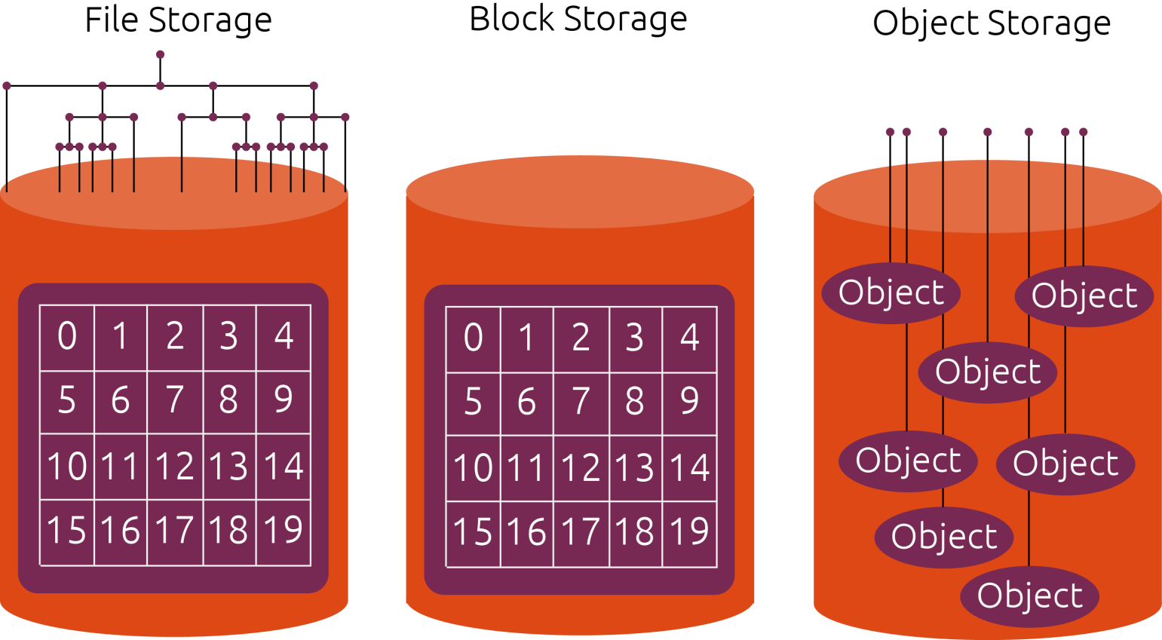
Cloud Delivery Models
IaaS Storage

Slide 42
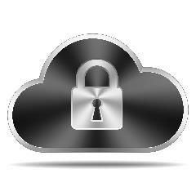

Cloud Delivery Models
IaaS Security issues
With IaaS in public cloud, we control VMs and services running on VMs. The
security issues that should be addressed are:
Data Leakage Protection and Usage Monitoring
Data stored in IaaS infrastructure in both private and public clouds must be closely monitored. Logs should be maintained showing when the data were accessed, by whom and from where. Policies for information need to be created and deployed.
In addition, transparent process can be created that monitors information usage.
End to End Logging and Reporting
The effective deployment of IaaS demands comprehensive logging and reporting in place. Robust logging and reporting solutions helps to keep track of where the information is, who accesses it, which machines are handling it and which storage arrays are responsible for it. These solutions are important for service management and optimization.

Slide 43


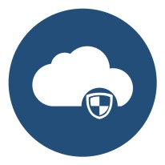
Cloud Delivery Models
IaaS Security
Authentication and Authorization
Robust authentication and authorization is essential for effective Data Loss Prevention. For every application, apart login ID and password, a two-factor or multi-factor authentication must be added.
Infrastructure Hardening
Infrastructure hardening is the act of applying security to each component of the infrastructure including: Web servers, application servers, identity and access management solutions, and database systems.
End-to-End Encryption
IaaS should take advantage of end-to-end encryption. The entire disk can be encrypted to prevent offline attacks. Also, all communication to host OS and VMs in the IaaS infrastructure should be encrypted using SSL/TLS.

Slide 44

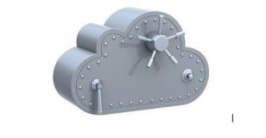
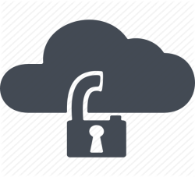
Cloud Delivery Models
Cloud Data Protection
Cloud data protection is a type of data protection model used to protect stored, static and moving data in the cloud. It is designed to implement optimal data storage, protection and security methodologies.
Cloud data protection provides and ensures various services and processes such as:
Data Integrity: Data are in the same form as its stored version. Data encryption is used to secure data from illegal editing and corruption.
Storage management: The cloud infrastructure must provide a secure and continuously available interface for data access as required. Logs of each data access, edit and copying event are maintained.
Infrastructure security: These are the collective processes, policies and measures that ensure cloud/storage infrastructure security.
Data Protection as a Service (DPaaS) which provides managed data protection services for stored cloud data is an example of cloud data protection.

Slide 45

Cloud Delivery Models
Cloud Pricing:
In general, Cloud providers use the pay-as-you-go pricing.
However, there are no standards when it comes to pricing across various cloud providers. Therefore, purchasing decisions are difficult for consumers.
The cloud companies may break down pricing based on whether the virtual machine is dedicated or shared by multiple tenants.
Costs may also be split by compute, storage and networking use on a per GB basis.

Slide 46
Cloud Delivery Models
Cloud Pricing:
According to a report from 451 Research Group some of the ways cloud providers price the services are:
Pricing Model | Description
On-demand pricing | Billed for consumption of virtual machines using a fixed unit price.
Reserved instances | Flat fee in advance with a discounted rate.
Spot pricing | Customers bid to gain access to resources whose price keeps varying.
Prepaid VM access | Customers pay a single fixed fee to access a specifically sized instance for the duration of the plan. It can also be a recurring monthly plan. During this duration they can have unlimited access to the VM.
Recurring resource pooling | Customers commit to purchase a quantity of resources (number of CPU cores, quantity of RAM) in advance on a recurring basis.
Prepaid Consumption | Customers pay a set amount at the beginning of a term, and costs of consumption are debited from this prepaid amount. Can be done in a recurring plan as well.

Slide 47
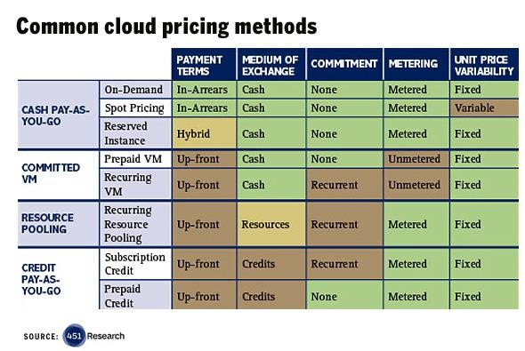
Cloud Delivery Models
Cloud Pricing:

Slide 48
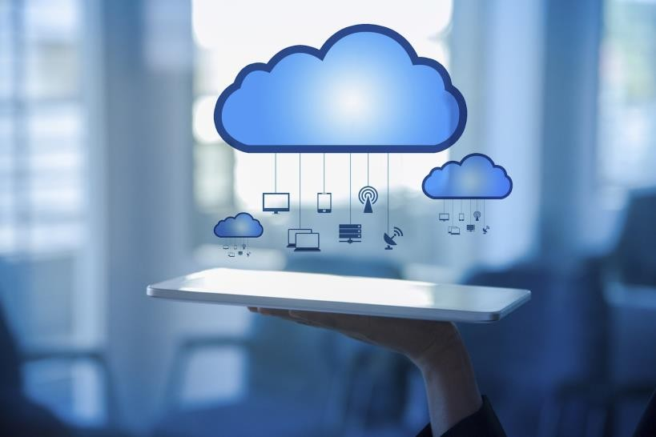
Cloud Delivery Models
Migrating to the Cloud:
Cloud migration is the process of moving data, applications or other business elements from an organization's onsite computers to the cloud, or moving them from one cloud environment to another.
Moving data or business elements from one cloud environment to another is called “cloud-to-cloud migration”.
The process of transitioning to a different cloud provider is called “cloud service migration”.
A successful migration to a cloud requires the use of
middleware such as a cloud integration tool.
33

Slide 49
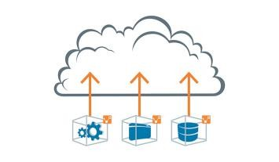
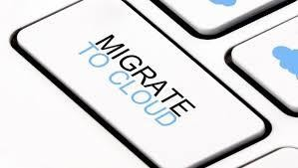
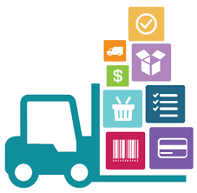
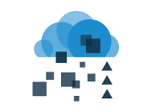
Cloud Delivery Models
Migrating to the Cloud:
There are three common approaches to migrate the on-premise applications to the cloud. They are:
Lift and Shift
the Lift and Shift approach involves the exact replication of the in-house applications in the cloud. There is no change made to the code or the design of applications. It involves much lesser time, cost and complexity when compared with other methods. Storage infrastructure and disaster recovery are common applications migrated using this approach.
Refactoring
Refactoring refers to changes made in the structure of the source code of the application in
order
to make it more efficient. The code is modified such that it becomes more scalable and reusable
without changing the functions of the application.
3. Modernization
The modernization application approach to cloud computing redesigns the application from ground-up, thus making it completely flexible for the cloud environment.
34

Slide 50
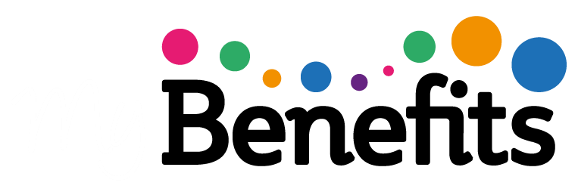
Cloud Delivery Models
IaaS Benefits:
Cost Savings – moving to cloud means lower Infrastructure costs, no maintenance overhead and no need to worry about ensuring uptime. The pay-as-you-go model of cloud offers significant cost savings since organisations pay only for what they use. The IaaS model demands no upfront charges, bandwidth utilization fees or minimum term commitments.
Scalability and Flexibility - the most important benefit of IaaS is the ability to scale up and down depending on the enterprise’s requirements. This on demand scalability results in flexibility and agility to respond to changing opportunities. This scalability also help in quickly building and dismantling test and development environments.
Faster Time to Market – time to market is the best way to beat competition. The scalability and flexibility IaaS provides can help in the getting the job done faster and get the service or product rapidly to the market.

Slide 51
Cloud Delivery Models
IaaS Benefits:
Support for DR, BC and high availability
Every enterprise requires a Disaster Recovery and Business Continuity plan in place. However, the technology behind these is often quite expensive and for organizations with more than one location managing of this infrastructure becomes more difficult.
IaaS provides a consolidated Disaster Recovery infrastructure which ensures quick recovery with no loss of data.
Focus on business growth
Moving to the cloud saves precious time that was being used to deal with maintenance issues and helps the business focus on growth.

Slide 52



Cloud Delivery Models
IaaS Risks:
Privacy and Security in the Cloud
One of the biggest concerns a business has while adopting IaaS is the security of confidential enterprise data and information. The credibility of the service provider is of utmost importance, the business must evaluate all possible alternatives before choosing one.
Downtime and Technical Difficulties
Systems face dysfunction and issues from time to time. Besides access to cloud is completely dependent on internet access, any connectivity issues will render the whole system useless.
Increased Vulnerability
Cloud-based solutions have a greater risk of attacks from malicious users and hackers.
Limited Control and Flexibility
IaaS means business has limited control over the execution of software and hardware that run on virtual environments.
52

Slide 53
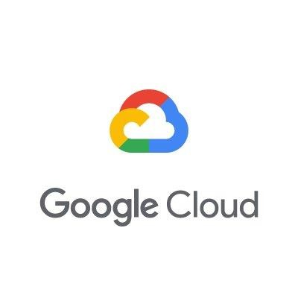
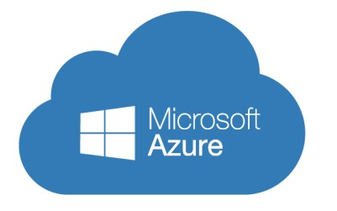
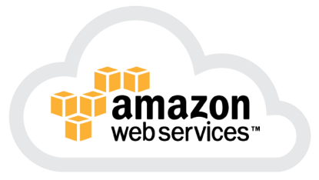

Cloud Delivery Models
Infrastructure as a Service – Some examples are:
Amazon EC2:
Windows Azure
Rackspace
Google Compute Engine
IaaS

Slide 54
Cloud Delivery Models
Self-Assessment Question
refers to the creation of a virtual resource such as a servers
Virtual Machine
Virtualization
Containers
Hypervisor
Answer: Virtualization

Slide 55
Cloud Delivery Models
Self-Assessment Question
A hypervisor is .
An operating system
An application
Answer: An operating system

Slide 56
Cloud Delivery Models
Self-Assessment Question
Select the correct option:
Container use less resources than VMs
VMs can initiate in milliseconds
More VMs can be operated in the same space used by one container
Containers have their own operating system
Answer: Container use less resources than VMs

Slide 57
Cloud Delivery Models
Self-Assessment Question
The document that defines the services the level of service expected by the service provider is called:
Google docs
Amazon EC2
Google App Engine
Azure cloud
Answer: Google App Engine

Slide 58
Cloud Delivery Models
Self-Assessment Question
is an example of a virtual Private Cloud:
Requirements document
Service level document
Service level agreement
Service contract
Answer: Service level agreement

Slide 59
Cloud Delivery Models
Self-Assessment Question
A can share a single physical network interface with multiple
virtual machines
Hypervisor
Virtual switch
Answer: Hypervisor

Slide 60
Cloud Delivery Models
Self-Assessment Question
The file storage allows users to:
Store data as blocks
Store active documents as files
Answer: Store active documents as files

Slide 61
Cloud Delivery Models
Self-Assessment Question
Object storage is ideal for storing:
Music files
Database
Answer: Music files

Slide 62
Cloud Delivery Models
Self-Assessment Question
Infrastructure hardening is:
Isolating each component of infrastructure.
Applying security to each component of the infrastructure.
Answer: Applying security to each component of the infrastructure.

Slide 63
Cloud Delivery Models
Self-Assessment Question
Cloud migration is the process of:
Moving data, applications or other business elements from an organization's onsite computers to the cloud.
Moving data, applications or other business elements from an organization's onsite computers to the cloud or from moving from one cloud environment to another.
Answer: Moving data, applications or other business elements from an organization's onsite computers to the cloud or from moving from one cloud environment to another.

Slide 64
Cloud Delivery Models
Self-Assessment Question
The Lift and Shift method is most suitable for migrating .
Disaster recovery applications
Web applications
Answer: Disaster recovery applications

Slide 65
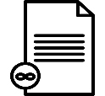
Cloud Delivery Models
Document Links
Topics | URL | Notes
Cloud Delivery Models | https://doublehorn.com/saas-paas- and-iaas-understanding/ | This link explains the three cloud delivery models namely SaaS, PaaS and IaaS.
Virtualization | https://www.techopedia.com/definiti on/719/virtualization | This link explains virtualization.
Service Level Agreement | http://whatiscloud.com/cloud_deploy ment_models/index | It contains links explaining Private, Public, Community, Hybrid and other deployment models for cloud.
IaaS Storage | https://securosis.com/blog/defending -cloud-data-how-iaas-storage-works | This link explains the types of storage in IaaS.
IaaS Security | https://ijcsmc.com/docs/papers/Marc h2014/V3I3201499a38.pdf | The link discusses the IaaS security issues.
IaaS benefits | https://statetechmagazine.com/article /2014/03/infrastructure-service-5- important-benefits | The link explains the 5 important benefits of IaaS.

Slide 66

Cloud Delivery Models
Video Links
Topics | URL | Notes
Cloud Delivery Models | https://www.youtube.com/watch?v=3 6zducUX16w | Explains the three types of cloud services – SaaS, PaaS and IaaS
Virtualization | https://www.youtube.com/watch?v=l 0DfHUWMjsU | The video gives an introduction to virtualization in cloud computing.
Service Level Agreement | https://www.youtube.com/watch?v= TDqF11rRobg | The video explains service level agreement.
IaaS Storage | https://www.youtube.com/watch?v= KduoinBNru4 | The video discusses file, block and object storage with examples.
IaaS Security | https://www.youtube.com/watch?v=1 3zrMe1immw | The video Iaas, Paas and SaaS security models
IaaS benefits | https://www.youtube.com/watch?v= LwBOgT761iQ | The video explains IaaS and its benefits

Slide 67
Cloud Delivery Models
Platform as a Service

Slide 68
Cloud Delivery Models
PaaS
Overview
IaaS vs PaaS
PaaS Examples
PaaS Benefits and Risks

Slide 69
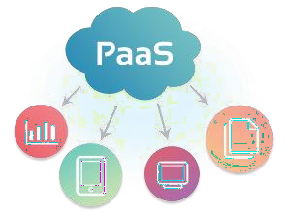
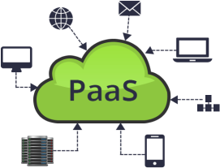
Cloud Delivery Models
PaaS – Platform as a Service
Platform as a service (PaaS) is a complete development and deployment environment in the cloud with resources that enable you to deliver everything from simple cloud- based apps to sophisticated, cloud-enabled enterprise applications.
You purchase the resources you need from a cloud service provider on a pay-as-you-go basis and access them over a secure Internet connection.
Who can benefit from PaaS?
Software developers can take advantage of a PaaS solution to build an application which they are planning to offer over the internet.
Web developers can use individual PaaS environments at every stage of the process to develop, test, and host their websites.
Businesses can develop their own internal software, particularly to create distinct ring- fenced development and testing environments.

Slide 70
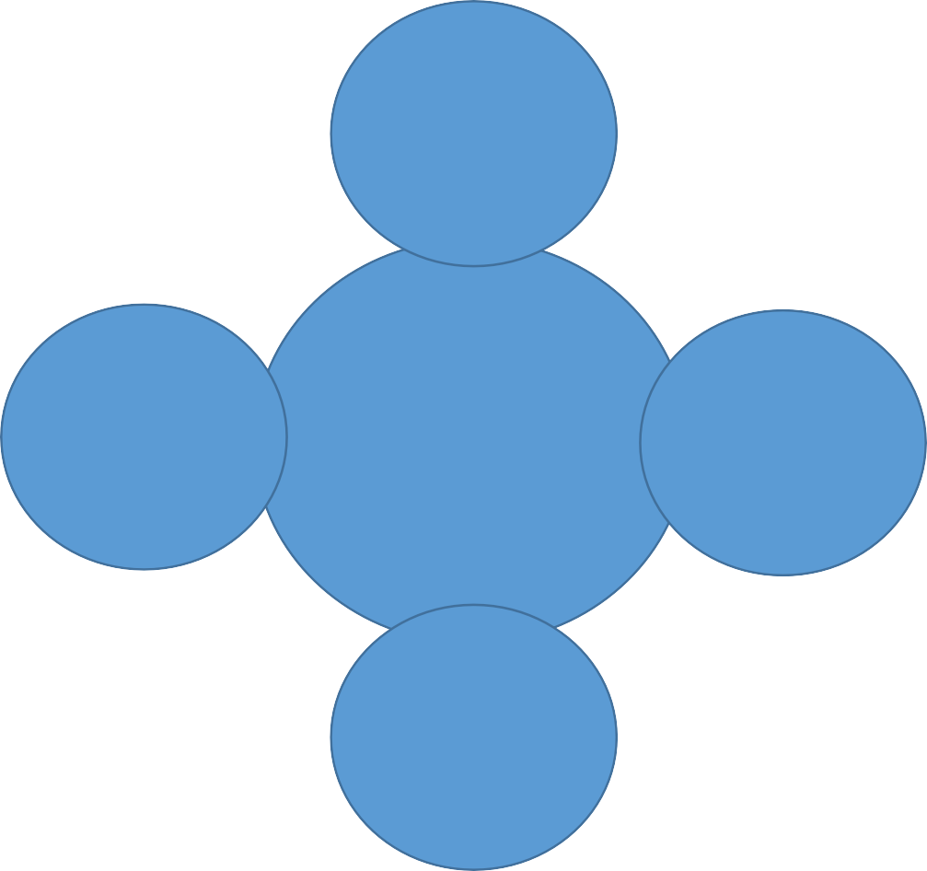
Cloud Delivery Models
PaaS – Platform as a Service
PaaS includes:
1. Infrastructure such as servers, storage and
networking
Operating
System
Middleware (such as IIS, Tomcat, Caching Services)
Development tools
Business Intelligence (BI) services
Database management systems (SQL Server, Oracle, MySQL)
Runtime (JRE and .NET Framework)
Middleware
PAAS
Database
PaaS is designed to support the complete web application lifecycle:
Building, Testing, Deploying, Managing and Updating.
Developme nt Platform

Slide 71
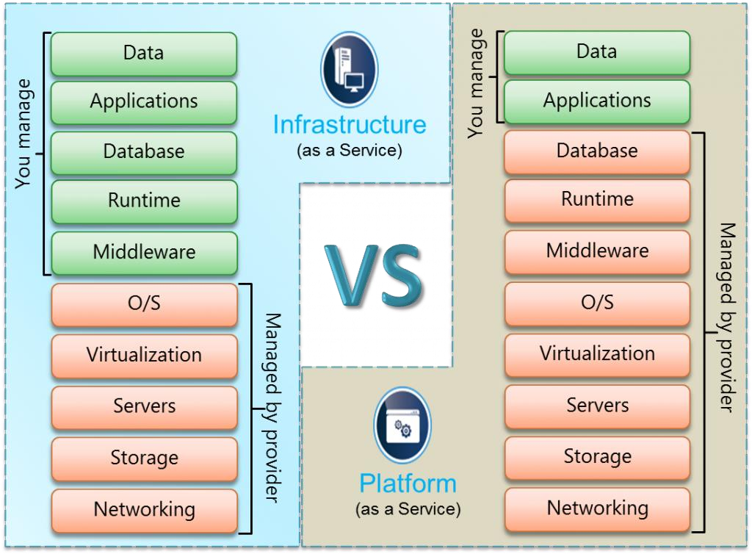
Cloud Delivery Models
IaaS vs. PaaS

Slide 72
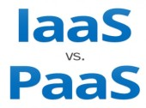
Cloud Delivery Models
IaaS vs. PaaS
IaaS | PaaS
IaaS refers to the cloud service model that provides on-demand infrastructure services to the customer. The infrastructure may refer to rentable resources such as computation power, storage, load-balancer, and so on. | Platform as a service (PaaS) is a complete development and deployment environment in the cloud. It includes infrastructure as well as middleware development tools and database management systems.
The IaaS provider is responsible for managing physical resources such as servers, networking, and storage. Virtualization and operating system are also managed by the provider. | In PaaS model, the application and data are managed by the user whereas the physical components, middleware, operating system, databases, and runtime are handled by the provider.
Examples include: Amazon EC2 Windows Azure Rackspace Google Compute Engine | Examples include: Windows Azure Force.com NETSUITE AT&T

Slide 73

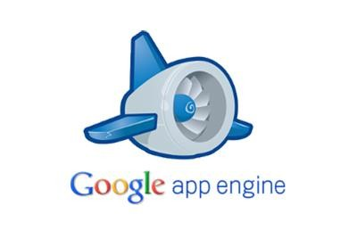
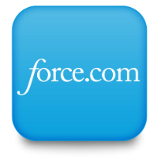
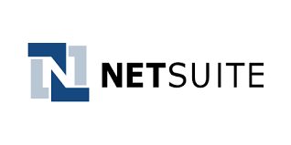
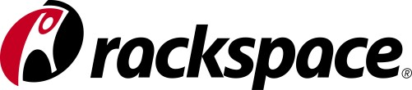
Cloud Delivery Models
Platform as a Service – Some examples are:
NetSuite
Windows Azure
Rackspace
Google App Engine
Microsoft azure
PaaS

Slide 74
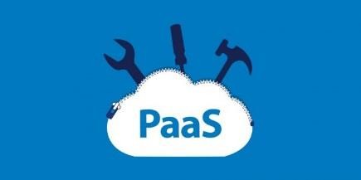
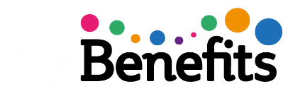
Cloud Delivery Models
PaaS Benefits
Reduced Development Time
The server side components such as web servers, storage, and networking are provided by the PaaS provider. The development team need not configure or maintain them. This saves time and results in faster development.
Support for Different Programming Languages
PaaS services support many different programming languages allowing the developers to develop simple web applications to enterprise cloud solutions on the same platform.
Easy Collaboration for Remote and Distributed Teams
In today’s world of freelancing and outsourcing, software development team may be distributed over different locations all over the world. PaaS services make it possible for these distributed teams to collaborate and allows them to access the same software platform from anywhere and at any time.
High Development Capabilities without Additional Staff
PaaS providers provide, maintain, and upgrade all hardware and middleware, thus
eliminating the need for staff to do all these tasks.
74

Slide 75


Cloud Delivery Models
PaaS Risks:
Although PaaS services have many benefits, they also come with some
disadvantages:
You have no control over the virtual machine that processes your data.
PaaS solutions are less flexible than IaaS. For example, you cannot create and delete several virtual machines at a time.
It comes with a predefined programming model which can result in vendor lock-in issues since you have to use only the languages offered.
Migration to the cloud can be difficult if the existing code is not supported by the provider.

Slide 76
Cloud Delivery Models
Self-Assessment Question
is a complete development and deployment environment in the cloud.
DaaS
PaaS
Answer: PaaS

Slide 77
Cloud Delivery Models
Self-Assessment Question
Select the component that is managed by the user in PaaS model.
Operating system
Middleware
Database
Application
Answer: Application

Slide 78
Cloud Delivery Models
Self-Assessment Question
is an example of PaaS.
Amazon EC2
Force.com
Answer: Force.com

Slide 79
Cloud Delivery Models
Self-Assessment Question
PaaS services support many different programming languages.
True
False
Answer: True

Slide 80
Cloud Delivery Models
Document Links
Topics | URL | Notes
Platform-as-a-Service | https://azure.microsoft.com/en- in/overview/what-is-paas/ | The link explains PaaS delivery model.
PaaS Benefits | https://rubygarage.org/blog/iaas- vs-paas-vs-saas | This link explains the PaaS benfits.

Slide 81
Cloud Delivery Models
Video Links
Topics | URL | Notes
Platform-as-a-Service | https://www.youtube.com/watch? v=whx01vzmlns | The video gives an overview of PaaS delivery model.
PaaS Benefits | https://www.youtube.com/watch? v=OCuHYef5Tzk | This video discusses the benefits of PaaS.

Slide 82
Cloud Delivery Models
Software as a Service

Slide 83
Cloud Delivery Models
SaaS
Overview
SaaS Examples
Office 365
Google G Suite
Salesforce.com
Evaluating SaaS
Impact of SaaS
Benefits and Risks

Slide 84

Cloud Delivery Models
Software as a Service – SaaS
Software as a service (SaaS) allows users to connect to and use cloud-based apps over the Internet. Common examples are email, calendaring, and office tools such as Microsoft Office 365.)
SaaS provides a complete software solution which you purchase on a pay- as-you-go basis from a cloud service provider.
You rent the use of an app for your organization and your users connect to it over the Internet, usually with a web browser. All of the underlying infrastructure, middleware, app software, and app data are located in the service provider’s data center.
The service provider manages the hardware and software and with the appropriate service agreement will ensure the availability and the security of the app and your data as well. SaaS allows your organization to get quickly up and running with an app at minimal upfront cost.
84

Slide 85

Cloud Delivery Models
Traditional Software vs SaaS
SaaS products are generally prebuilt and consumed using the provided functionality without significant customization, as in the case of Google Gmail users who simply access the web- based standard email and calendaring application.
Traditional software requires a capital expense to purchase and operating expenses to install, update, and maintain. Traditional software application management follows a predictable process:
Identify software meeting requirements.
Perform capital acquisition for identified software.
Install software to client computers.
Patch software in maintenance cycle.
Perform acquisition for software update.
Install software update to client computers.
Return to maintenance cycle until next software update.

Slide 86


Cloud Delivery Models
By contrast, SaaS application management requires far fewer steps for the consuming organization:
Identify cloud service providers whose software meets organizational requirements.
Obtain licensing for identified software service access.
After this, all maintenance, including patches and updates, are handled by the cloud SaaS provider.

Slide 87


Cloud Delivery Models
SaaS Benefits
Business agility is enhanced by ensuring that mobile workers have
access to key business applications from anywhere anytime.
Displaced employees retain operational capability during widespread natural disasters, and organizational data resources can simply be moved to cloud provider storage outside of the affected area in case of a disaster.
Organizations can take advantage of resource sharing between employees working in different time zones or across different geopolitical zones.
4. Organizations can implement sustainable “green” initiatives such as remote travel-free employees, who do not require leased space, dedicated equipment, and costly environmental control in expensive central office facilities.
87

Slide 88


Cloud Delivery Models
SaaS Risks
Usage Risk
The risk an organization incurs when using the app such as using it for some critical function or for storing sensitive information will be considered high risk. Whereas an app for say scheduling get together for employees with pets will be considered low risk.
Data Security Risk
While Usage Risk focuses on how your organization is using the app, Data Security Risk focuses on how the service provider is handling your data. It is crucial to know whether it is encrypted in transit or at rest and whether the app controls are in place to determine how the data are stored and who can view it.

Slide 89
Cloud Delivery Models
SaaS Risks
SaaS Provider Operational Risk
This includes issues such as the uptime SLA guaranteed by the provider, whether there is 24×7 support, the compliance certificates obtained by the provider and the Disaster Recovery strategy of the provider.
SaaS Provider Application Risk
Application risk is the inherent risk of an app such as how the app handles authentication and authorization? The development practices used by the provider to address configuration vulnerabilities and session management vulnerabilities.

Slide 90




Cloud Delivery Models
Platform as a Service – Some examples are:
Salesforce.com
Office 365
Zoho
Google G Suite
SaaS

Slide 91

Cloud Delivery Models
Office 365
Microsoft Office 365 is the cloud application suite developed by Microsoft, and is considered
one of the best cloud-based services for small, medium, and large businesses.
It works on the SaaS model, all the software is installed and maintained on the cloud.
Office 365 is a cloud-based service that provides the best business emailing solutions and productivity tools like Mailbox, Skype, One Drive, Online Docs, Online Word, Yammer, Online Excel, and Calendar which helps you and your team to work from anywhere, anytime, and on any device. In short, it is the Office whenever and wherever you need it.
Office 365 helps business to increase employee productivity by saving time, money, and resources.
There are different Office 365 plans to which users can subscribe.

Slide 92

Cloud Delivery Models
Office 365

Slide 93

Cloud Delivery Models
Office 365 Services
Office 365 offers:
Office online is similar to MS office except that the office online apps can be accessed only through internet making it easier for users in different locations to collaborate and share data.
Exchange online is an application for IT managers. It gives centralized control of all mailboxes of the company to set the mail policy, security, and filter spams. It also offers data loss prevention capabilities.
SharePoint online is a web application to modernize the on-premise infrastructure. It allows to create team sites or portals to share to discover and collaborate on content from inside or outside the organization.
4. Yammer is an enterprise-based social networking service that helps an organization connect and interact privately.
93

Slide 94

Cloud Delivery Models
Office 365 apps
94

Slide 95


Cloud Delivery Models
Office Online Apps
Office online apps include:
Mail box: You can stay connected to your emails and it also has OWA (Outlook Web Access) which is similar to Outlook.
Skype for Business: Skype for Business which combines instant messaging, voice, online meetings and video conferencing, providing users with the rich and consistent experience of a consolidated system.
Word Online: Create, edit, collaborate, and share your word documents or files from anywhere.
Excel Online: Analyze and organize your data in Excel spreadsheets & workbooks.
PowerPoint Online: Create powerful presentations and share with your team from anywhere
anytime.
OneNote Online: Helps you in information gathering and multi-user collaboration. Users can make handwritten or typed notes, drawings, screenshots, videos, and audios.
Calendar: Helps you to Invite, set reminders and track RSVP to manage your schedule.
OneDrive: Save your photos, videos, documents, spreadsheets, etc., and access them from
anywhere.
Docs: Share your documents (Word, Excel, PowerPoint, OneNote, Sway, and PDF). You can upload the documents from Computer or OneDrive.
95

Slide 96
Cloud Delivery Models
Office 365 Features and Benefits
Easily Accessible: Office 365 applications and services can be accessed from
anywhere in the world provided you have internet access.
Automatic Updates: Ready-to-use software are provided by the cloud itself to its users with automatic updates.
Prevents Data Loss: Your Data are safe as it is backed up on the cloud.
Great Security: Every Office 365 user gets a unique username and password to authenticate their user account and proactive monitoring help keep customer data safe.
Reduces IT Expenses: It reduces your IT Infrastructure cost as well as the cost of updating the software. Pay as you want – You pay to subscribe the tools and services as per your requirements.

Slide 97

Cloud Delivery Models
Google G Suite
Google G Suite is the new Google App for businesses.
Google G Suite is the cloud-based alternative to suites like Microsoft Office.
It comes with some free apps such as Gmail but the suite itself needs
subscription – monthly or annually billed.
The basic plan of G Suite gives 30GB storage, which is double the space available with free plan. The business plan offers unlimited storage (in case of more than five employees) along with a better admin control panel and the Vault for archiving emails.

Slide 98

Cloud Delivery Models
Google G Suite

Slide 99

Cloud Delivery Models
Google G Suite
Google G Suite offers:
Business email addresses (name@company.com)
Video and voice calls
Online calendars
Online text documents, spreadsheets, and slides
Project sites (a way to build simple websites or intranet)
Security and admin controls
24/7 phone and email support.
On the Unlimited plan, in addition to the above you get
Advanced admin controls for Drive
Audit and reporting insights for Drive content and sharing
Google Vault for eDiscovery covering emails, chats, docs, and files
Advanced search
More options when it comes to file exports
Email archives
Set message-retention policies
Litigation holds on inboxes
99

Slide 100


Cloud Delivery Models
Salesforce.com
Salesforce.com is a cloud computing and social enterprise software as a service (SaaS) provider based in San Francisco. It was founded in March 1999, in part by former Oracle executive Marc Benioff.
Salesforce.com is best known for its Salesforce Customer Relationship Management (CRM) product which is composed of Sales Cloud, Service Cloud, Marketing Cloud, Commerce Cloud, Analytics Cloud, IoT Cloud, App Cloud, Health Cloud, Financial Services Cloud, Force.com, and Chatter.
What is Customer Relationship Management (CRM)?
Customer relationship management (CRM) manages the business's single most important goal – satisfying the customers. Customers are king in any business, CRM helps manage the interactions that are made with customers from the date they start business with the company.
100

Slide 101

Cloud Delivery Models
Salesforce.com Services
101

Slide 102



Cloud Delivery Models
Salesforce.com Services
Cloud Services helps track customer information and interactions. It supports sales,
marketing, and customer support in both B2B and B2C contexts.
Marketing Cloud helps personalize email marketing, engage mobile messaging, generally manage ad campaigns for customer acquisition and create a one-to-one customer journeys across channels.
Service Cloud is a service platform for customer service and support. It includes a call center-like case-tracking feature and a social networking plug-in for conversation and analytics. It enables faster resolving of customer problems.
Community Cloud helps build communities which include customers, employees, and partners for developing deeper customer relationships. It allows customers to interact with each other, increase sales by connecting partners, and boost employee productivity through online collaboration.
102

Slide 103




Cloud Delivery Models
Salesforce.com Services
Commerce Cloud allows businesses to manage digital commerce with
integrated solutions for commerce, point of sale, and order management.
Analytics Cloud is a business intelligence platform that allows organizations to instantly get important answers and start making data- driven decisions.
Salesforce App Cloud is a collection of development tools that allows developers to quickly create applications that will run on the Salesforce platform.
8. Salesforce IoT Cloud is a platform in Salesforce.com that harnesses the power of internet of things (IoT) and turns data generated by customers, devices, partners, and sensors into meaningful action. It allows users to process massive quantities of data, build rules with intuitive tools, and engage with customers in real time.
103

Slide 104



Cloud Delivery Models
Salesforce.com Services
9. Salesforce Financial Services Cloud helps deliver experiences that drive client loyalty through personalized tools, allows more visibility into existing household opportunities and the ability to track referrals, allows instant access to all client data in one central location, and addresses regulatory compliance.
Salesforce Health Cloud is a health IT CRM system that incorporates record management services with the doctor–patient relationship. Health cloud creates an individual profile from each member including demographics, communications and any other pertinent information all in one location. It allows patients to track progress toward health goals and care plans.
Chatter is an enterprise social network within the Salesforce platform. It helps drive productivity by connecting employees wherever they are.
104

Slide 105





Cloud Delivery Models
Salesforce.com
Sales Force provides Sales as a Service (SaaS) that excels at sales tracking, measuring, and organising the business and is cost effective.
Web CRM Pays For Itself More Quickly. Removing the need for a huge capital investment on IT infrastructure and technical maintenance staff and streamlining existing IT costs with PaaS. It offers a faster return on investment.
Web-based CRM Will Transform Business Faster. Hosted CRM implementations take weeks or months instead of the 12-month average of client/server CRM tools.
Hosted CRM is more User Friendly. Salesforce's simple-to-use interface appeals even to non-technical
users.
On-Demand CRM Provides Unlimited Scalability. Salesforce software uses a multi-tenant approach – there is no single instance of the software, so it is faster and cheaper to implement.
Web CRM Features Painless Upgrades. Deployments of new features on the customer management systems are instantaneous, resulting in access to the latest version always.
105

Slide 106

Cloud Delivery Models
Evaluating SaaS
106

Slide 107



Cloud Delivery Models
Evaluating SaaS – User Perspective
Unlike your relationship with a software vendor who provides you with on-premises software and then exits till the customer needs something, the customer has a close relationship with a SaaS provider, beginning with the subscription purchase. When entrusting the SaaS provider with sensitive business data stored at the provider’s site, a business becomes dependent on the provider on an ongoing basis for smooth running of systems, innovation, support, and sometimes training. Treading carefully during the selection process can reduce risks to a great extent.
When evaluating SaaS applications the following criteria should be considered:
1. Strength of SaaS provider’s security processes and standards:
The application and data resides at the vendor’s side; therefore, security is utmost important. The security standards practiced by the vendor should be checked to see if they are compliant with the organization’s security model.
Work with the vendor on a SLA for security that satisfies the organization’s needs. Include penalties for lack of service on agreed terms in SLA.
Also, processes for disaster recovery, backup, and restore must be included.
107

Slide 108



Cloud Delivery Models
Evaluating SaaS – User Perspective
Provider’s ability to provide the flexibility needed to meet your needs:
Flexibility includes ease of adding and dropping features from your subscription plan like
add seats and whether it can be done online.
Being able to drop the subscription with cause without penalty such as in case of SaaS vendor fails to provide the agreed level of service.
Being able to customize the SaaS application to suit the organisation’s needs.
How difficult is it to get your data back in case if you decide to cancel the subscription?
History of the provider’s regard for its SLAs:
Since we are at the mercy of the SaaS provider for the services to be delivered, it is important to ensure the reliability of the provider by looking at the previous SLA performance records.
Provider’s business viability and future outlook:
Select a SaaS provider that is going to be in business for a long time. In selecting a SaaS provider, you are looking for a business partner who will not go out of business in a year. You should look at a provider’s experience in providing SaaS solutions, examine financial information, predicted growth of the business.
108

Slide 109


Cloud Delivery Models
Evaluating SaaS – Vendor Perspective
From a vendor’s perspective, adopting the SaaS model for business needs the following considerations:
Financial concern: Unlike the traditional model which relied on upfront licensing fee for the software you provide, the cloud model of business relies on the periodic subscription fee. The key to survival is to keep the cash flow by retaining customers. This is a challenge since the switching fee for customers is significantly low.
Compliance issues : Vendors should make sure that national and global compliance requirements are taken care of and regulations are met.
Operational efficiency: 24/7 operability, highly effective business continuity plans, and high- caliber data management and security protocols.
Configuration and Customization: profitability for the SaaS vendors comes from economies of scale that SaaS deployment offers like multitenancy. There should be policies in place for the amount of tailoring of the software to clients’ needs that is allowed.
109

Slide 110

Cloud Delivery Models
Impact of SaaS
As businesses continue to modernize and digitize their offerings, more companies are turning toward cloud systems to handle their software and data needs. By following the SaaS model, companies are seeing faster innovations enabled by deeper analytics, while reducing the amount of space that is required by traditional data centers.
SaaS platforms are based upon user experience and functionality. With the ability to incorporate real-time analytics, businesses can uniquely customize the site experience for each user. Modern SaaS platforms also allow for efficient scalability.
The adoption of SaaS and cloud-based software is a cross-industry phenomenon. Health tech, fintech, retail tech offerings are emerging alongside enterprise applications as a service (e.g., ERP, CRM, HR, accounting).
110

Slide 111

Cloud Delivery Models
Other Cloud services:
Data as a service (DaaS): data are stored on cloud and made available to users on demand regardless of their geographic location.
Desktop as a service provides for a virtual desktop.
Storage as a service (SaaS) provides data storage infrastructure.
Test environment as a service: we can rent a test setup to quickly test our application.
Security as a service (SECaaS): we can allow the cloud provider to take care of the security.
API as a service is a SaaS exposed as an API (Application Programming Interface). It allows users to access web services such as Google Maps, credit card processing and payroll processing.
111

Slide 112

Cloud Delivery Models
Cloud Delivery Models Considerations
Due to economies of scale, cloud Providers have the potential to offer state-of-the-art cloud Ecosystems that are resilient and secure—far more secure than the environments of Consumers who manage their own systems. This has the potential to greatly benefit many organizations.
Cloud-based information systems are exposed to threats that can have adverse effects on organizational operations (i.e., missions, functions, image, or reputation), organizational assets, individuals, and other organizations.
Malicious entities can exploit both known and unknown vulnerabilities to compromise the confidentiality, integrity, or availability of the information being processed, stored, or transmitted by those systems.
There are many types of risk that organizations need to address: program management, investment, budget, legal liability, safety, inventory, supply chain, security, and more.
112

Slide 113
Cloud Delivery Models
Self-Assessment Question
SaaS stands for .
Storage as a service
Software as a service
Answer: Software as a service
113

Slide 114
Cloud Delivery Models
Self-Assessment Question
SaaS enables:
Employees from different geographical locations to collaborate.
Create virtual machines on the cloud
Answer: Employees from different geographical locations to collaborate.
114

Slide 115
Cloud Delivery Models
Self-Assessment Question
Data security risk is:
The way an organization uses the cloud app.
The way the service provider handles the organization’s data.
Answer: The way the service provider handles the organization’s data.
115

Slide 116
Cloud Delivery Models
Self-Assessment Question
is an example of SaaS.
MS office
Office 365
Answer: Office 365
116

Slide 117
Cloud Delivery Models
Self-Assessment Question
Salesforce.com is a cloud computing and social enterprise storage as a service (SaaS) provider.
True
False
Answer: False
117

Slide 118
Cloud Delivery Models
Self-Assessment Question
Cloud applications are utilized by application developers:
True
False
Answer: False
118

Slide 119
Cloud Delivery Models
Document Links
Topics | URL | Notes
SaaS | https://azure.microsoft.com/en-in/overview/what- is-saas/ | This link gives an overwiew about SaaS model.
SaaS benefits | https://www.workbooks.com/blog/benefits-of- saas | This link explains the benefits of SaaS.
SaaS Risks | https://www.identropy.com/blog/IAM- blog/bid/97683/4-SaaS-Risks-Every-CSO-Needs- to-Know | The link explains the risks to be considered when opting for SaaS services.
Office 365 | https://www.wroffy.com/introduction-office-365- amazing-features/ | This link explains the features and benefits of office 365.
Google G Suite | https://blog.teamwave.com/2016/09/30/g-suite- review/ | The link discusses aboutte apps Google G suite offers
Evaluating SaaS | https://searchcloudapplications.techtarget.com/tip /Evaluating-SaaS-providers-Uncovering-vendor- weaknesses | The link presents the evaluating criteria from the user’s perspective
119

Slide 120
Cloud Delivery Models
Video Links
Topics | URL | Notes
SaaS | https://www.youtube.com/watch?v=zqABiwIjqPU | This video gives an overview about SaaS model.
SaaS benefits | https://www.youtube.com/watch?v=j4jHIMhijNA | This video explains the benefits and risks of SaaS.
Office 365 | https://www.youtube.com/watch?v=ondmRYEKWcM | This video explains the features and benefits of office 365.
Google G Suite | https://www.youtube.com/watch?v=jMWrsRNveSI | The video gives an introduction about Google G suite
120

Slide 121
Cloud Delivery Models
Assignment
You need to answer below sets of problem. These sets of questions are meant for testing unit I.
Explain the different cloud delivery models.
Compare IaaS and PaaS.
List the benefits and risks of IaaS, PaaS, and SaaS.
Discuss the impact of SaaS.
Explain the criteria to be considered for evaluating SaaS from vendor’s perspective.
Explain how Salesforce.com can help business growth.
Explain the importance of office 365 over desktop Ms office suite.
121

Slide 122
Cloud Delivery Models
Summary
Infrastructure as a service (IaaS) is a form of cloud computing that provides virtualized computing resources over the internet.
Infrastructure as a Service is also called Hardware as a Service (HaaS).
Virtualization is a fundamental mechanism for delivering cloud services.
A hypervisor is an operating system, which makes things happen in an orderly manner. The hypervisor sits at the lowest levels of the hardware environment.
A container is designed to virtualize a single application instead of the entire operating system.
A service level agreement (SLA) is a contract between a service provider (either internal or external) and the end
user that defines the level of service expected from the service provider.
A virtual private cloud (VPC) is a hybrid model of cloud computing in which a private cloud solution is provided within a public cloud provider’s infrastructure.
A virtual network is like a LAN. It is an isolated address space that can be divided into automatically routed subnets.
Block storage devices provide fixed-sized raw storage capacity. Each storage volume can be treated as an
independent disk drive and controlled by an external server operating system.
Data kept on object storage devices, consist of the object data and metadata, it can be any kind of data, photos, videos, and log files.
Cloud data protection is a type of data protection model used to protect stored, static and moving data in the cloud. It is designed to implement optimal data storage, protection, and security methodologies.
122

Slide 123
Cloud Delivery Models
Summary
Cloud migration is the process of moving data, applications, or other business elements from an organization's onsite computers to the cloud, or moving them from one cloud environment to another.
Platform as a service (PaaS) is a complete development and deployment environment in the cloud, with resources that enable you to deliver everything from simple cloud-based apps to sophisticated, cloud-enabled enterprise applications.
Software as a service (SaaS) allows users to connect to and use cloud-based apps over the Internet. Common examples are email, calendaring and office tools such as Microsoft Office 365.)
123

Slide 124
Cloud Delivery Models
Document Links
Topics | URL | Notes
Cloud Delivery Models | https://doublehorn.com/saas-paas-and-iaas- understanding/ | This link explains the three cloud delivery models namely SaaS, PaaS and IaaS.
Virtualization | https://www.techopedia.com/definition/719/virtualiz ation | This link explains virtualization.
Service Level Agreement | http://whatiscloud.com/cloud_deployment_models/i ndex | It contains links explaining Private, Public, Community, Hybrid and other deployment models for cloud.
IaaS Storage | https://securosis.com/blog/defending-cloud-data- how-iaas-storage-works | This link explains the types of storage in IaaS.
IaaS Security | https://ijcsmc.com/docs/papers/March2014/V3I3201 499a38.pdf | The link discusses the IaaS security issues.
IaaS benefits | https://statetechmagazine.com/article/2014/03/infras tructure-service-5-important-benefits | The link explains the 5 important benefits of IaaS.
124

Slide 125
Cloud Delivery Models
Document Links
Topics | URL | Notes
Platform-as-a-Service | https://azure.microsoft.com/en- in/overview/what-is-paas/ | The link explains PaaS delivery model.
PaaS Benefits | https://rubygarage.org/blog/iaas-vs-paas-vs- saas | This link explains the PaaS benfits.
125

Slide 126
Cloud Delivery Models
Document Links
Topics | URL | Notes
SaaS | https://azure.microsoft.com/en-in/overview/what-is- saas/ | This link gives an overwiew about SaaS model.
SaaS benefits | https://www.workbooks.com/blog/benefits-of-saas | This link explains the benefits of SaaS.
SaaS Risks | https://www.identropy.com/blog/IAM- blog/bid/97683/4-SaaS-Risks-Every-CSO-Needs-to- Know | The link explains the risks to be considered when opting for SaaS services.
Office 365 | https://www.wroffy.com/introduction-office-365- amazing-features/ | This link explains the features and benefits of office 365.
Google G Suite | https://blog.teamwave.com/2016/09/30/g-suite- review/ | The link discusses aboutte apps Google G suite offers
Evaluating SaaS | https://searchcloudapplications.techtarget.com/tip/E valuating-SaaS-providers-Uncovering-vendor- weaknesses | The link presents the evaluating criteria from the user’s perspective
126

Slide 127
Cloud Delivery Models
Video Links
Topics | URL | Notes
Cloud Delivery Models | https://www.youtube.com/watch?v=36zducUX16w | Explains the three types of cloud services – SaaS, PaaS and IaaS
Virtualization | https://www.youtube.com/watch?v=l0DfHUWMjsU | The video gives an introduction to virtualization in cloud computing.
Service Level Agreement | https://www.youtube.com/watch?v=TDqF11rRobg | The video explains service level agreement.
IaaS Storage | https://www.youtube.com/watch?v=KduoinBNru4 | The video discusses file, block and object storage with examples.
IaaS Security | https://www.youtube.com/watch?v=13zrMe1immw | The video Iaas, Paas and SaaS security models
IaaS benefits | https://www.youtube.com/watch?v=LwBOgT761iQ | The video explains IaaS and its benefits
127

Slide 128
Cloud Delivery Models
Video Links
Topics | URL | Notes
Platform-as-a-Service | https://www.youtube.com/watch?v=whx01vzmlns | The video gives an overview of PaaS delivery model.
PaaS Benefits | https://www.youtube.com/watch?v=OCuHYef5Tzk | This video discusses the benefits of PaaS.
128

Slide 129
Cloud Delivery Models
Video Links
Topics | URL | Notes
SaaS | https://www.youtube.com/watch?v=zqABiwIjqPU | This video gives an overview about SaaS model.
SaaS benefits | https://www.youtube.com/watch?v=j4jHIMhijNA | This video explains the benefits and risks of SaaS.
Office 365 | https://www.youtube.com/watch?v=ondmRYEKWcM | This video explains the features and benefits of office 365.
Google G Suite | https://www.youtube.com/watch?v=jMWrsRNveSI | The video gives an introduction about Google G suite
129

Slide 130
Cloud Delivery Models
E-Book Links
Topics | URL | Page Number
Cloud Delivery Models | http://www.nortonaudio.com/Ficheiros/111840873X_Cloud.pdf | Page 29 to 31
IaaS | http://www.nortonaudio.com/Ficheiros/111840873X_Cloud.pdf | Page 39-41
PaaS | http://www.nortonaudio.com/Ficheiros/111840873X_Cloud.pdf | Page 35-39
SaaS | http://www.nortonaudio.com/Ficheiros/111840873X_Cloud.pdf | Page 32-34
130

